Slide 1
Project: SF080 FAC Dashboard
Division PED / Department IED / Section MIT

Slide 2

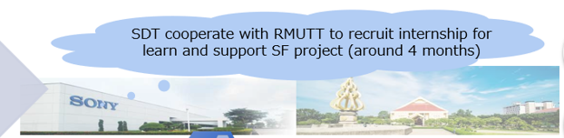
IE/MIT Internship Introduce
Item | Description
PIC | Education : Rajamangala University of Technology Thanyaburi Major : Computer Engineering
Project assignment | SF080 FAC Dashboard
Project concept | To develop FAC Dashboard by .NET, MVC and SQL database
Project advisor | Mr. Nattapong Chitcharoen
Training knowledge | SDT business knowledge, web development by .NET, MVC and SQL database
Trainer | Mr.Patchara Khuenpet
Period | 4 Jul’22 to 23 Oct’22
Mr. Nonthawat Imarom
Mr. Jirapat Jindapol
S2022022
S2022021
Notes:
Hi my name is Nonthawat and mr. …….. We’re from rajamangala University of technology thanyaburi. We are studying at the Faculty of Computer Engineering.
And for the project assignment in this Internship is SF080 Fac Dashboard The concept is ……. My project advisor is Mr. …….. For the training knowledge is …..
Trainer is Mr. …….. Period of time this internship is since fourth of July to twenty-third October .

Slide 3
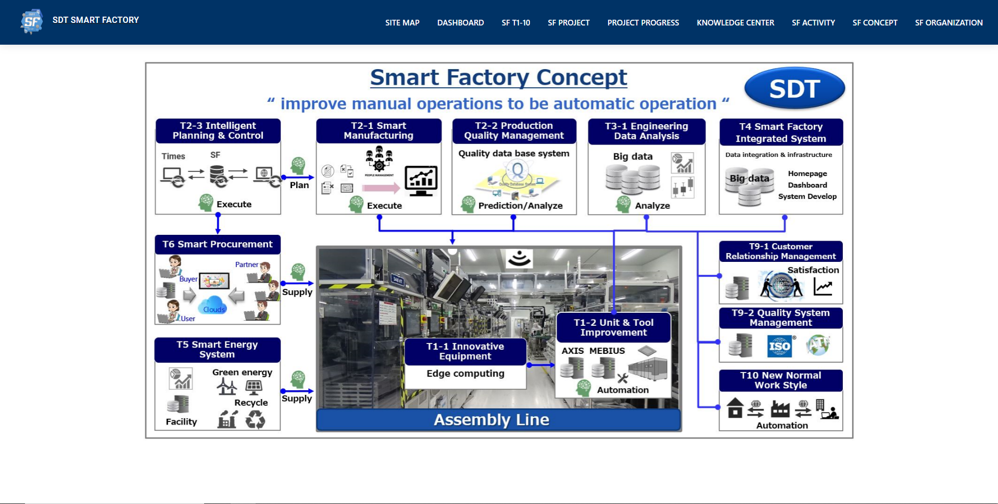
Project Assignment
The task that assign to this internship.
Assignment
Notes:
And for the assignment is the smart factory concept in T5 smart energy system

Slide 4
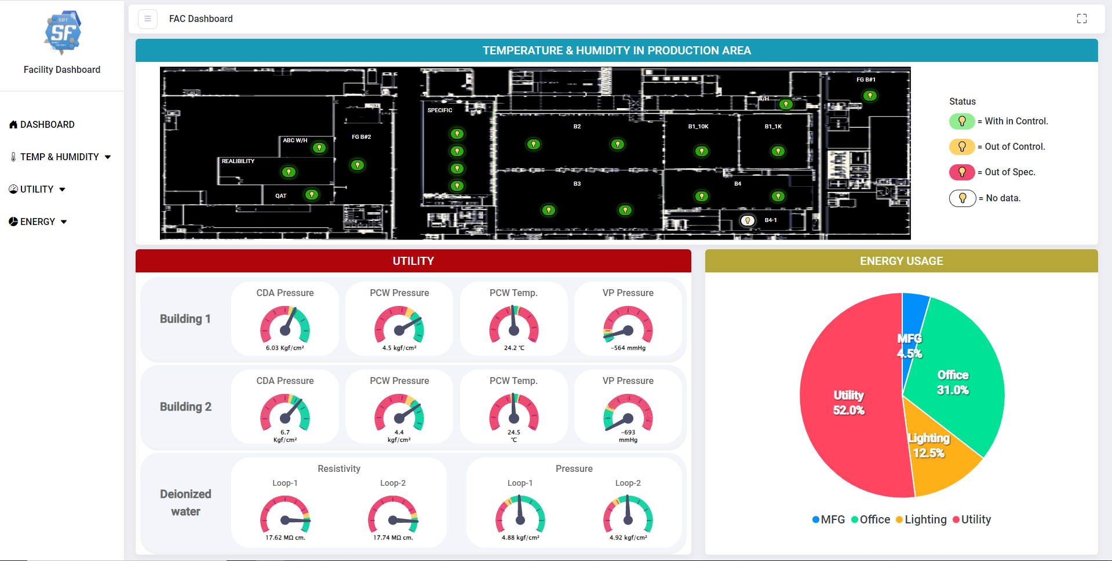





SF080 : FAC Dashboard
Dashboard
Export data from BAS to Facility Structure DB. And Generate data to Dashboard.
FAC Department
IT Department
Private Network
Sony Network
Every Hour
Export Data
Generate
LOAD
BAS
(Building Automation System)
Facility_RAW
Facility Structure DB
Generate
Notes:
First Situation is FAC Department has BAS It's a driver
thats control all of Utility supply such as Temperature, Humidity,
Electrical system and Water System (กด)but it's a private network
It unable to view the data outside the network (กด) so IT department
has to export the data into facility raw and load it into facility structure
database in Sony Network (กด)And the work of this project is to generate
it to the dashboard.(1)

Slide 5
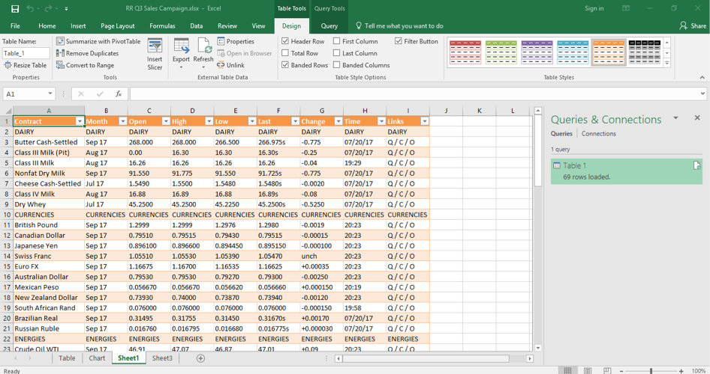

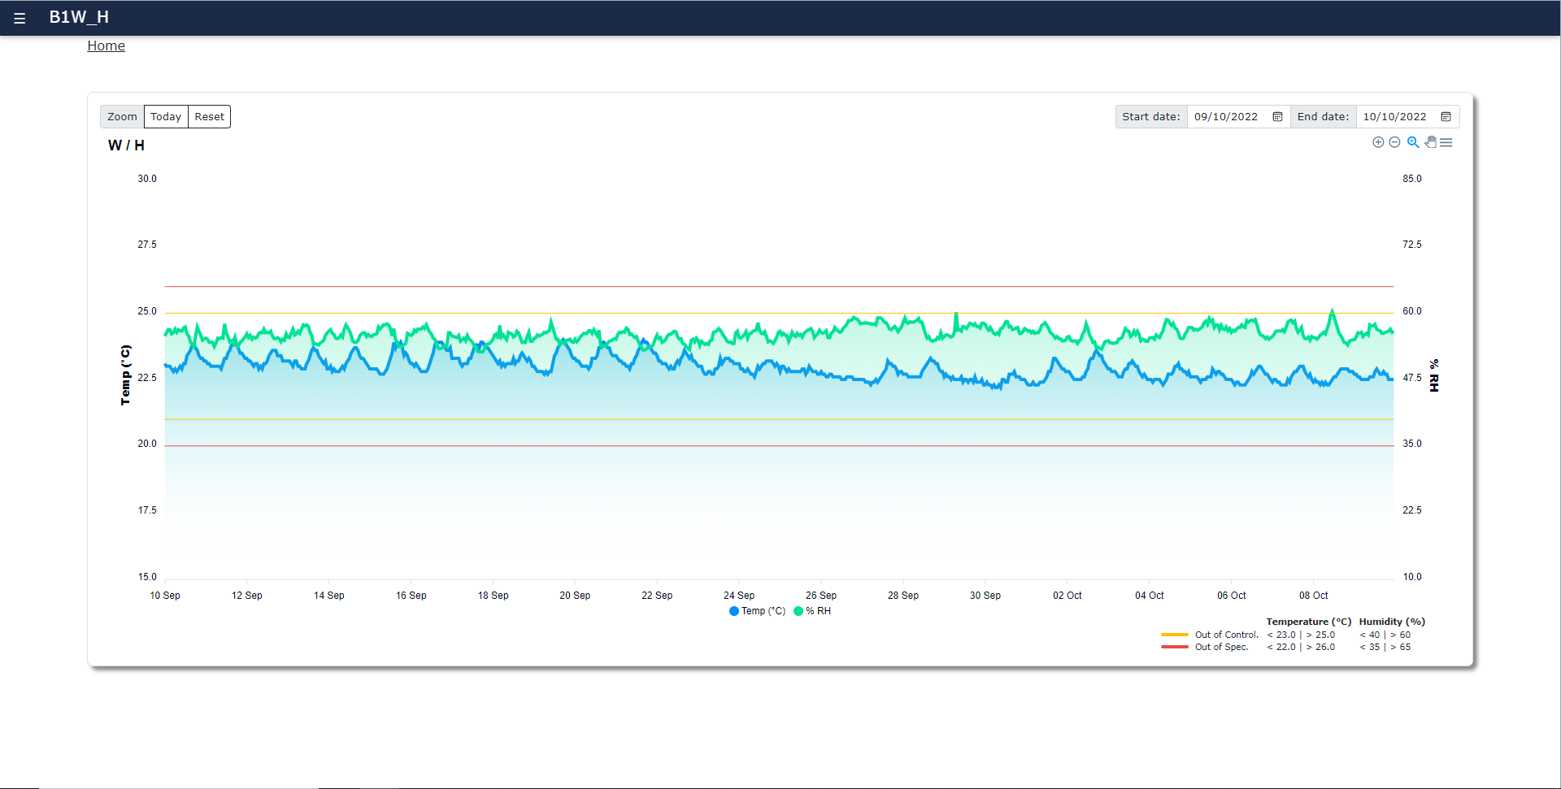
As Is
FAC Dashboard (Problem)
Before and After having a project and problem causing in this project.
LOAD
Facility_RAW
Data in Excel
FAC
Facility Structure DB
To Be
LOAD
FAC
Facility_RAW
Facility Structure DB
Dashboard
Notes:
why is dashboard because the dashboard is easily to see what going on in the
Data better than data table in the excel it can be know if there is something wrong with the facility or not
and can be managed it as soon as possible.

Slide 6



Requirement FAC Dashboard
Requirement received from the SF-T5 team .
Requirement FAC Dashboard
Temp. & Humidity
Utility
Energy Usage
Light button
show status
Gauge chart show status
Pie chart show status
Notes:
and for the create dashboard we need the requirement to generate
It so FAC Department has a requirement that have temp&humid that light button show status Utility is gauge chart show status and Energy usage is pie chart show status

Slide 7
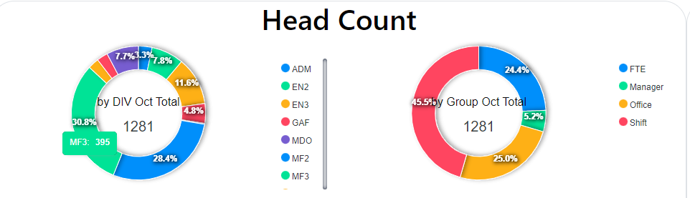
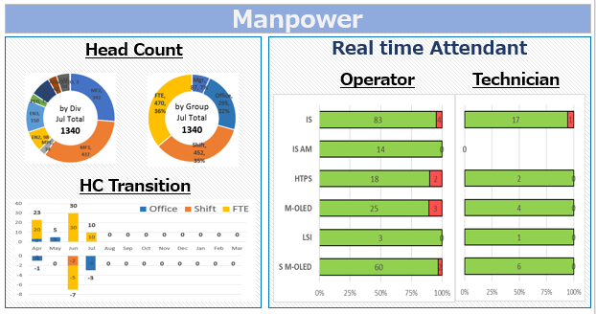
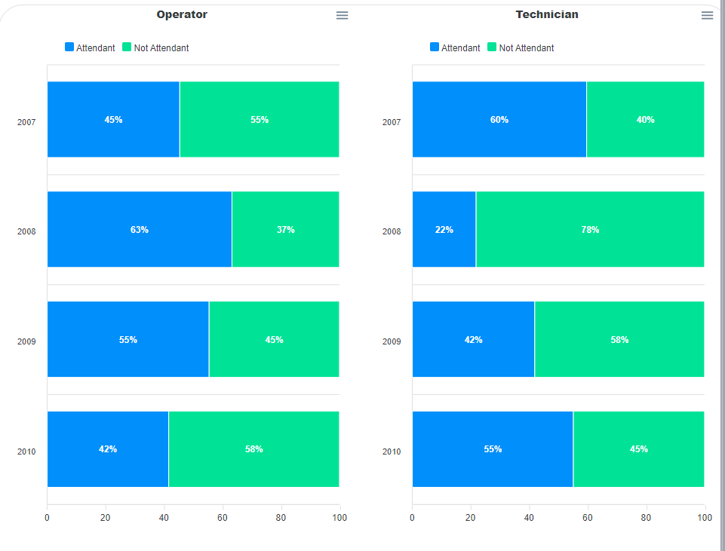
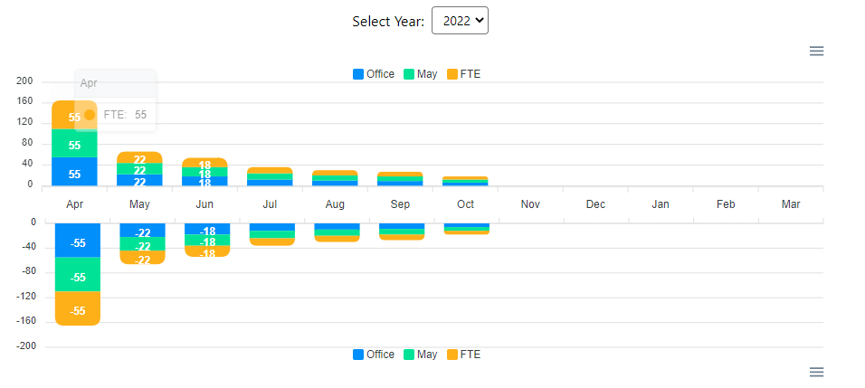
Requirement Manpower Dashboard
Requirement received from SF-T4 team.
Head Count (Donut Chart)
Realtime Attendant
HC Transition (Stacked Column Chart)
Notes:
and we have created Manpower dashboard too and the requirement
of manpower dashboard is Head count , Real time attendant, and HC Transition

Slide 8
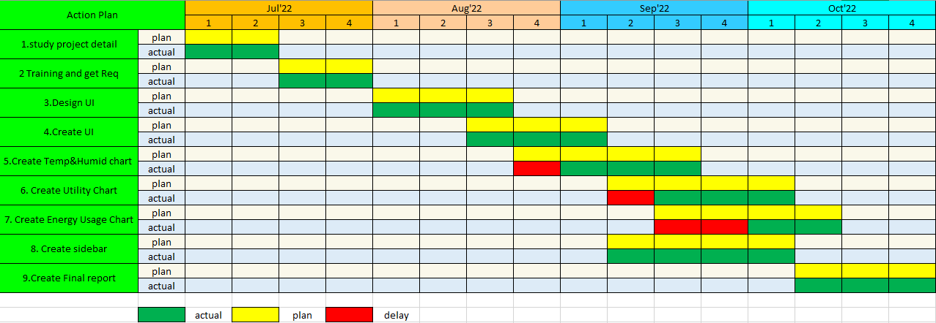
Internship Schedule
Overview of the schedule for this internship.
Notes:
This is the schedule that overview for this internship. In first month, we have study project detail and training to be ready for the project that we
have received and for the next three months are the months
that we have embarked on a project.

Slide 9







Training and Self Learning
Training received from Trainer and self-learning for this project.

Slide 10


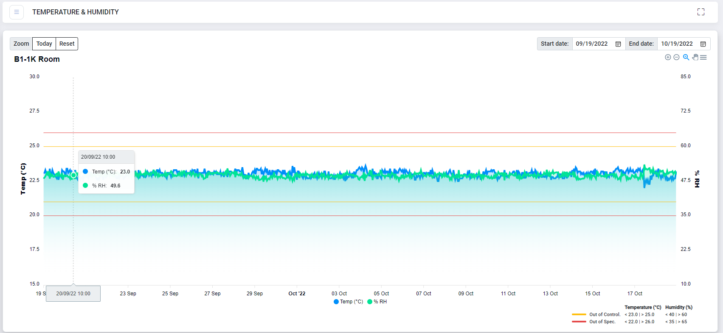
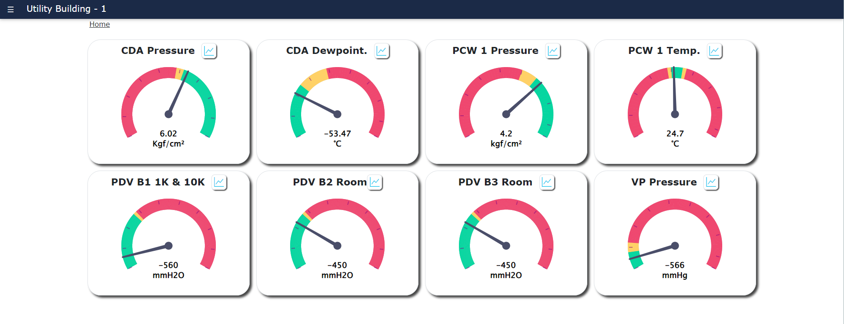
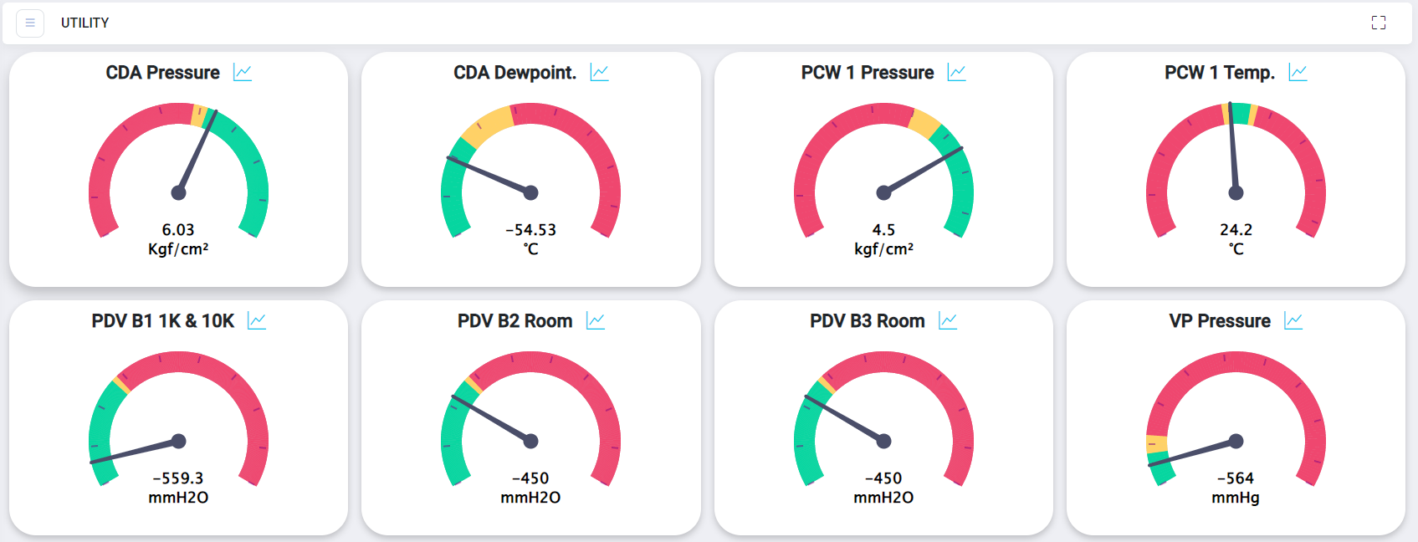
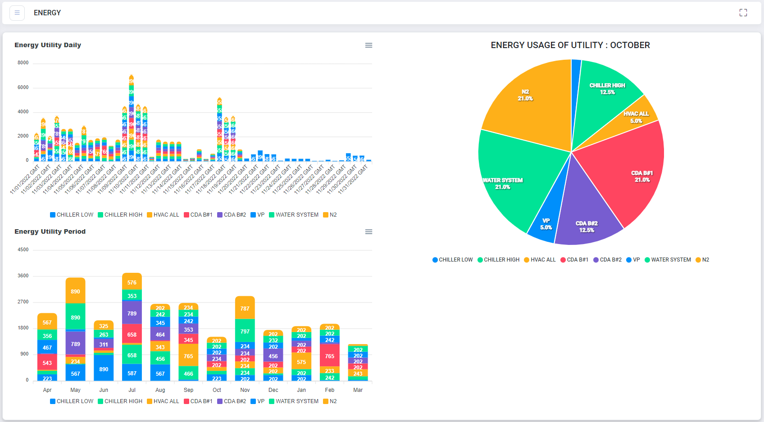
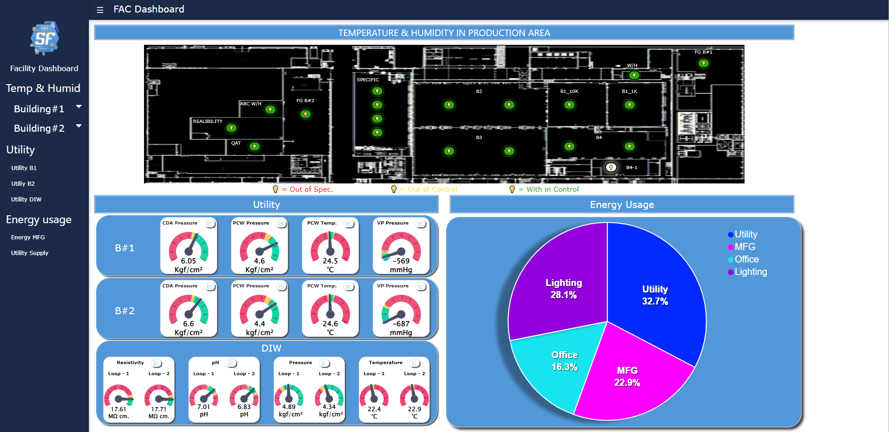
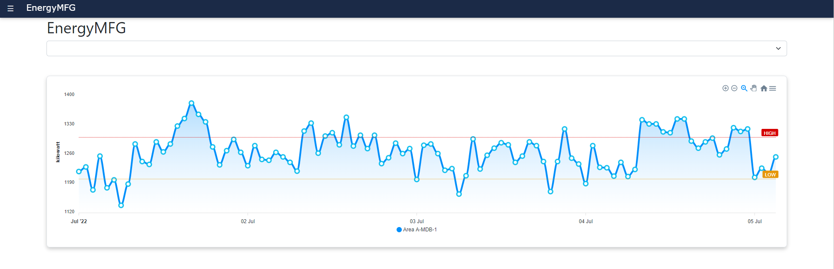
Database and Tools
Tools for this project.
Database
Tools
Result
Instance : DB_FACILITY
1. Temperature & Humidity
1. Temperature & Humidity
Stored procedures :
SP_Get_Temp_and_Humidity
SP_GetTable_Temp_and_Humidity
2. Utility
2. Utility
Stored procedures :
SP_Get_Chart_Utility
3. Energy Usage
Stored procedures :
SP_ShowEnergy_TEST
4. Dashboard
3. Energy Usage
4. Dashboard
Stored procedures :
SP_Get_Realtime_Temp
SP_Get_Utility
SP_Get_Energy

Slide 11
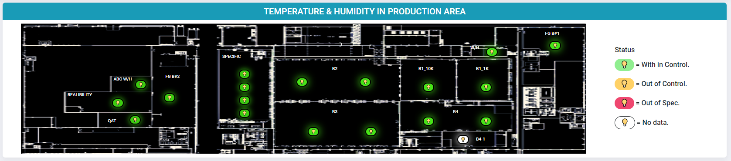
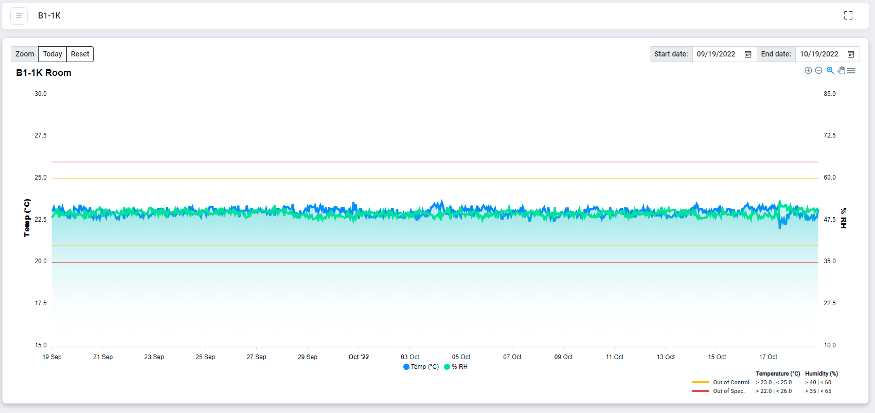
Temperature and Humidity
Structure and Operation of Centralized dashboard
1
Centralized dashboard : To create the centralized dashboard by Data Summary of Temperature and Humidity on page.

Slide 12
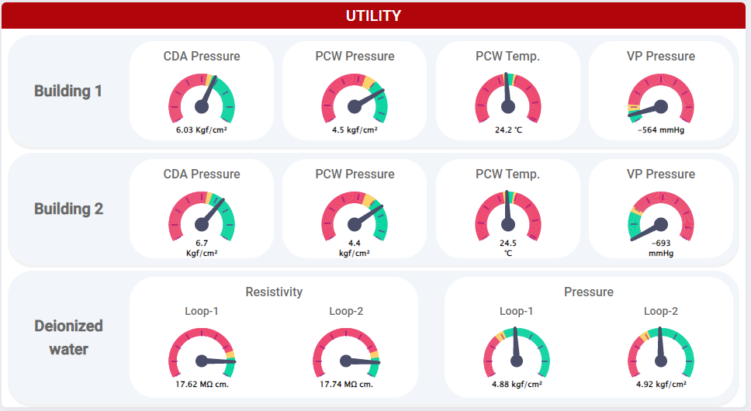
Utility
2
Centralized dashboard : To create the centralized dashboard by Data Summary of Utility on page.

Slide 13
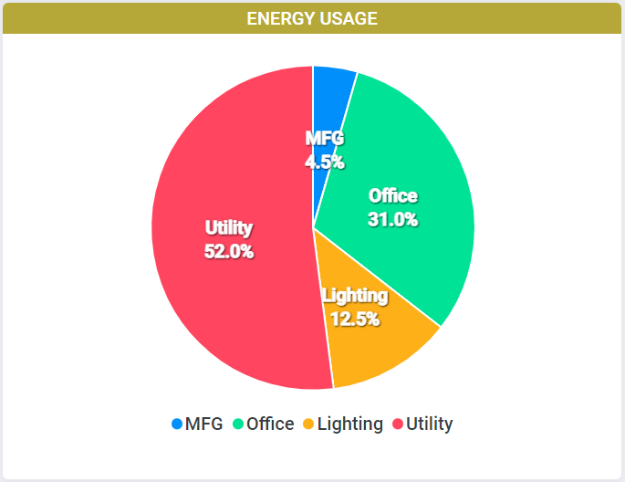
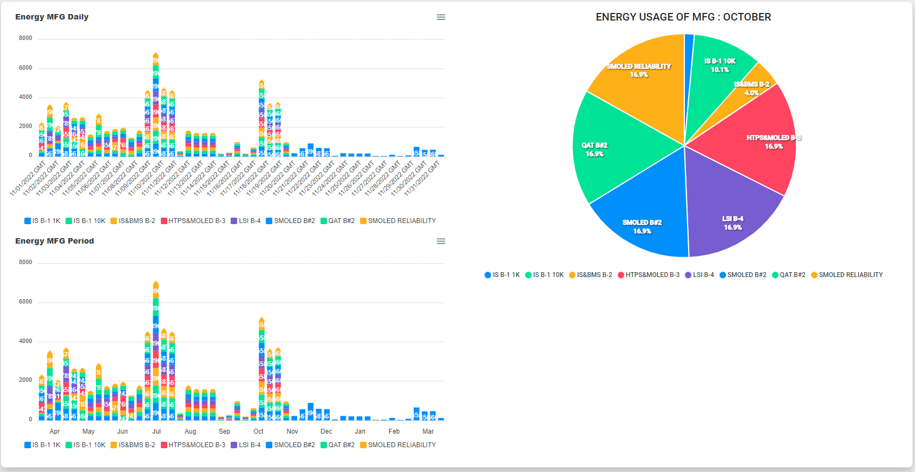
Energy Usage
3
Centralized dashboard : To create the centralized dashboard by Data Summary of Energy Usage on page.

Slide 14
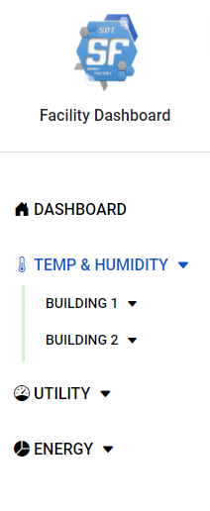
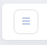
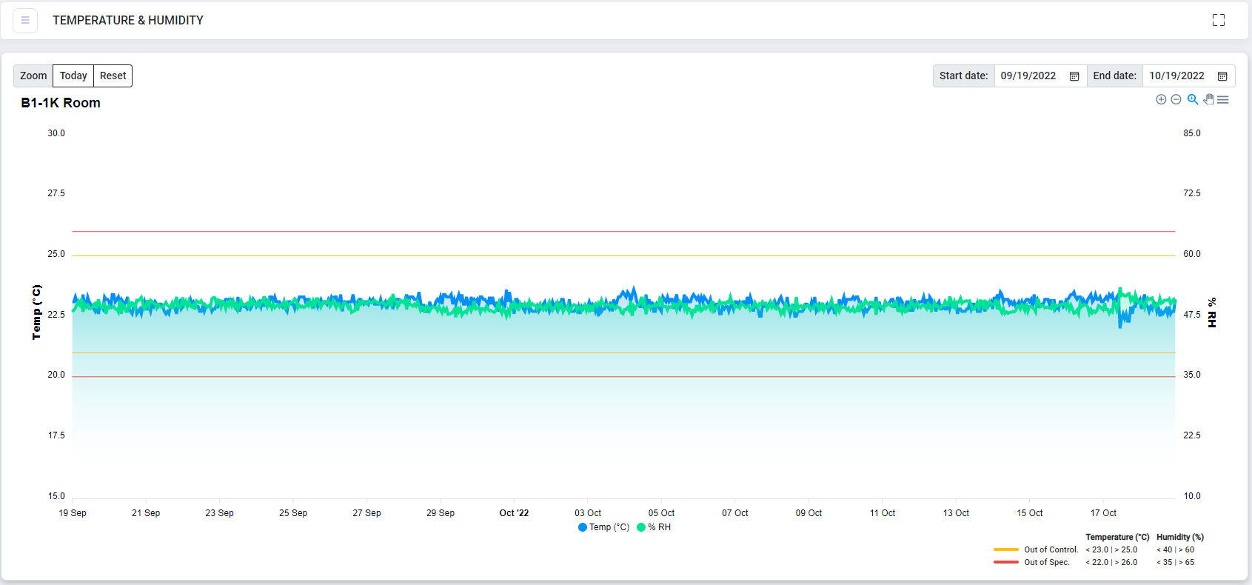
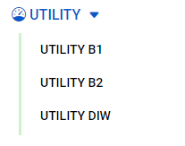
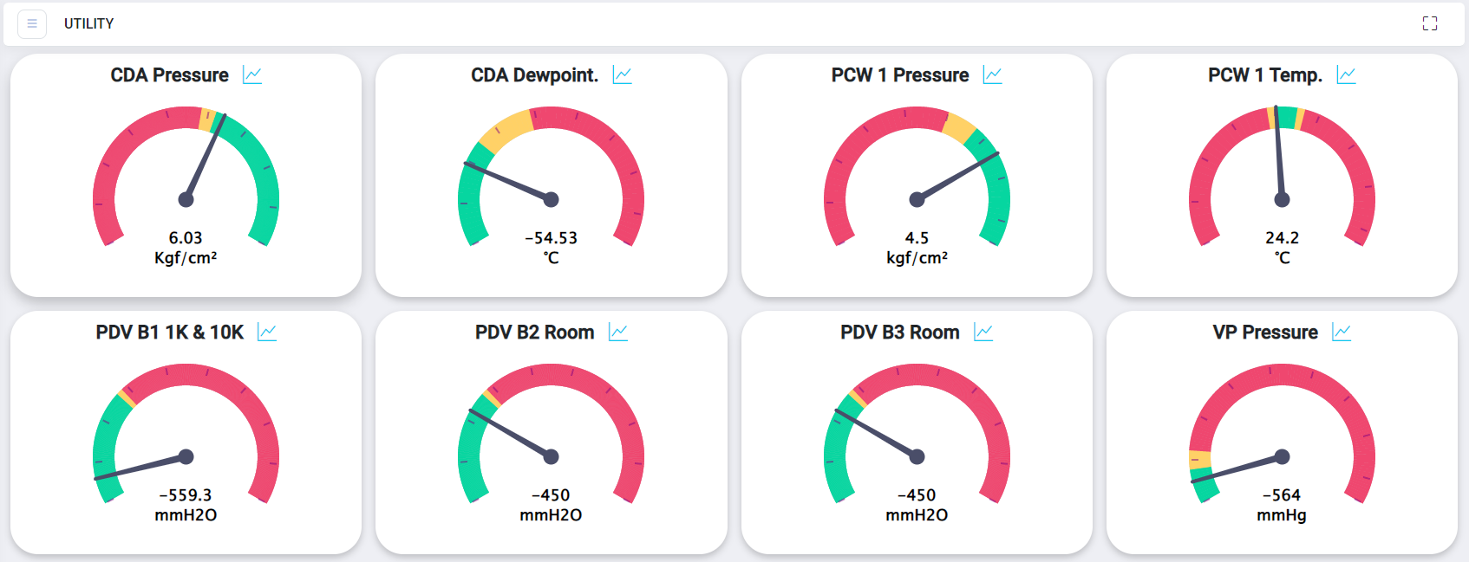
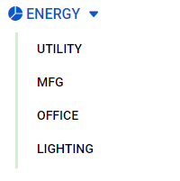


Link to all Status
4
Centralized dashboard : To create Sidebar by include link to all status of facility dashboard.
Button for turn on and off sidebar
Link to dashboard
Temp & Humid show Trend(History)
Utility show Gauge Chart
Energy Usage show graph

Slide 15
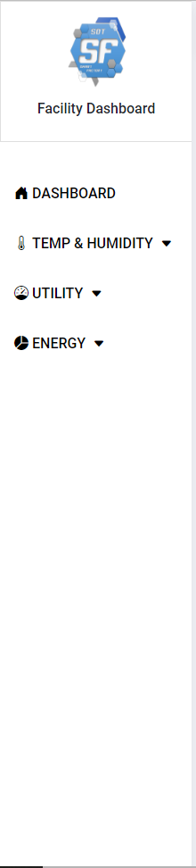
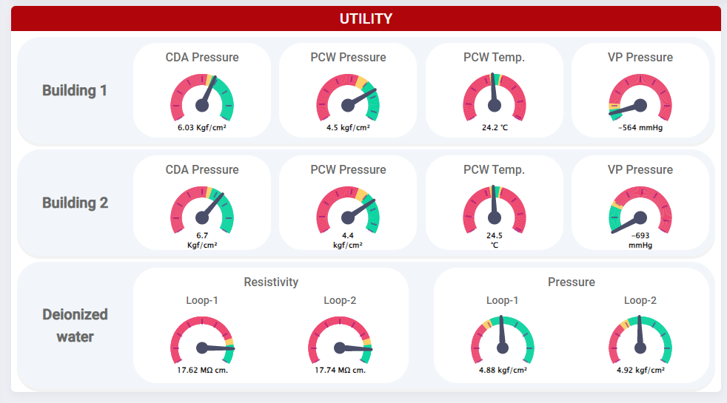
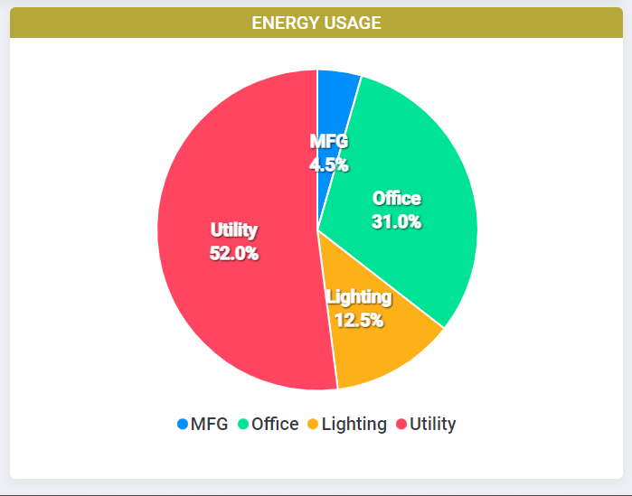
Overall, of FAC Dashboard
5
Centralized dashboard : To create the centralized dashboard by include all Data Summary to one page.

Slide 16
Demo

Slide 17




The result of Company
Benefit that the company will be received.
Easy access the data.
Easy to summary information
All the Employee can view the dashboard.
FAC Team can act as soon as possible for the error.

Slide 18




The result of Internship
Internship for 3 months and 13 days (4 July 2022 – 23 October 2022)
Monday – Friday (8.00 a.m. – 17.30 p.m.)
Learned how to deal with many problem.
Learned about better time management.
Have the experience of working in the company.
Learned about Culture, Organization, and working in the facility.

Slide 19
Appendix

Slide 20
Energy Usage
3
Centralized dashboard : To create the centralized dashboard by Data Summary of Energy Usage on page.
Category Name
Click chart for link to
data detail graph
Value

Slide 21
Utility
2
Centralized dashboard : To create the centralized dashboard by Data Summary of Utility on page.
System Name
Value
Range for check value

Slide 22
Temperature and Humidity
Structure and Operation of Centralized dashboard
1
Centralized dashboard : To create the centralized dashboard by Data Summary of Temperature and Humidity on page.
Data of Today and
Reset to default display
Show Status Temperature and Humidity.
Change color when value is out of control or out of spec.
Link to Trend(History).
Room Name
Select Date
Room Name
Zoom In
Zoom Out
Panning
Explain the meaning of color
Out of Control line
Out of spec. line
Information to Check Data is within a certain range.

Slide 23
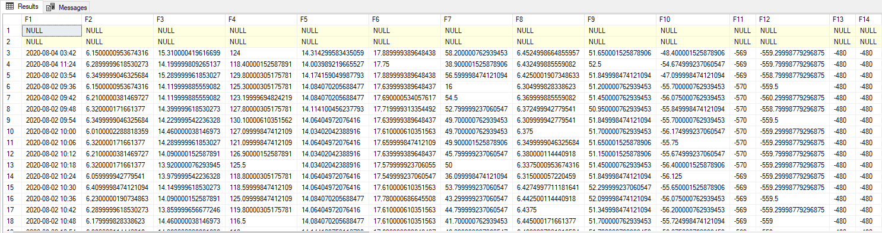

Job Responsibility and tools
Responsibilities and tools for this project
Front-End
Back-End
Internship Support
Trainer Support
Instance : DB_FACILITY
Stored procedures SP_Get_Temp_and_Humidity
Stored procedures : SP_Get_Utility
Stored procedures : SP_ShowEnergy_TEST
Stored procedures : SP_Get_Realtime_Temp
Stored procedures :SP_Get_Utility
Stored procedures :SP_Get_Energy
Tools
Tools

Slide 24
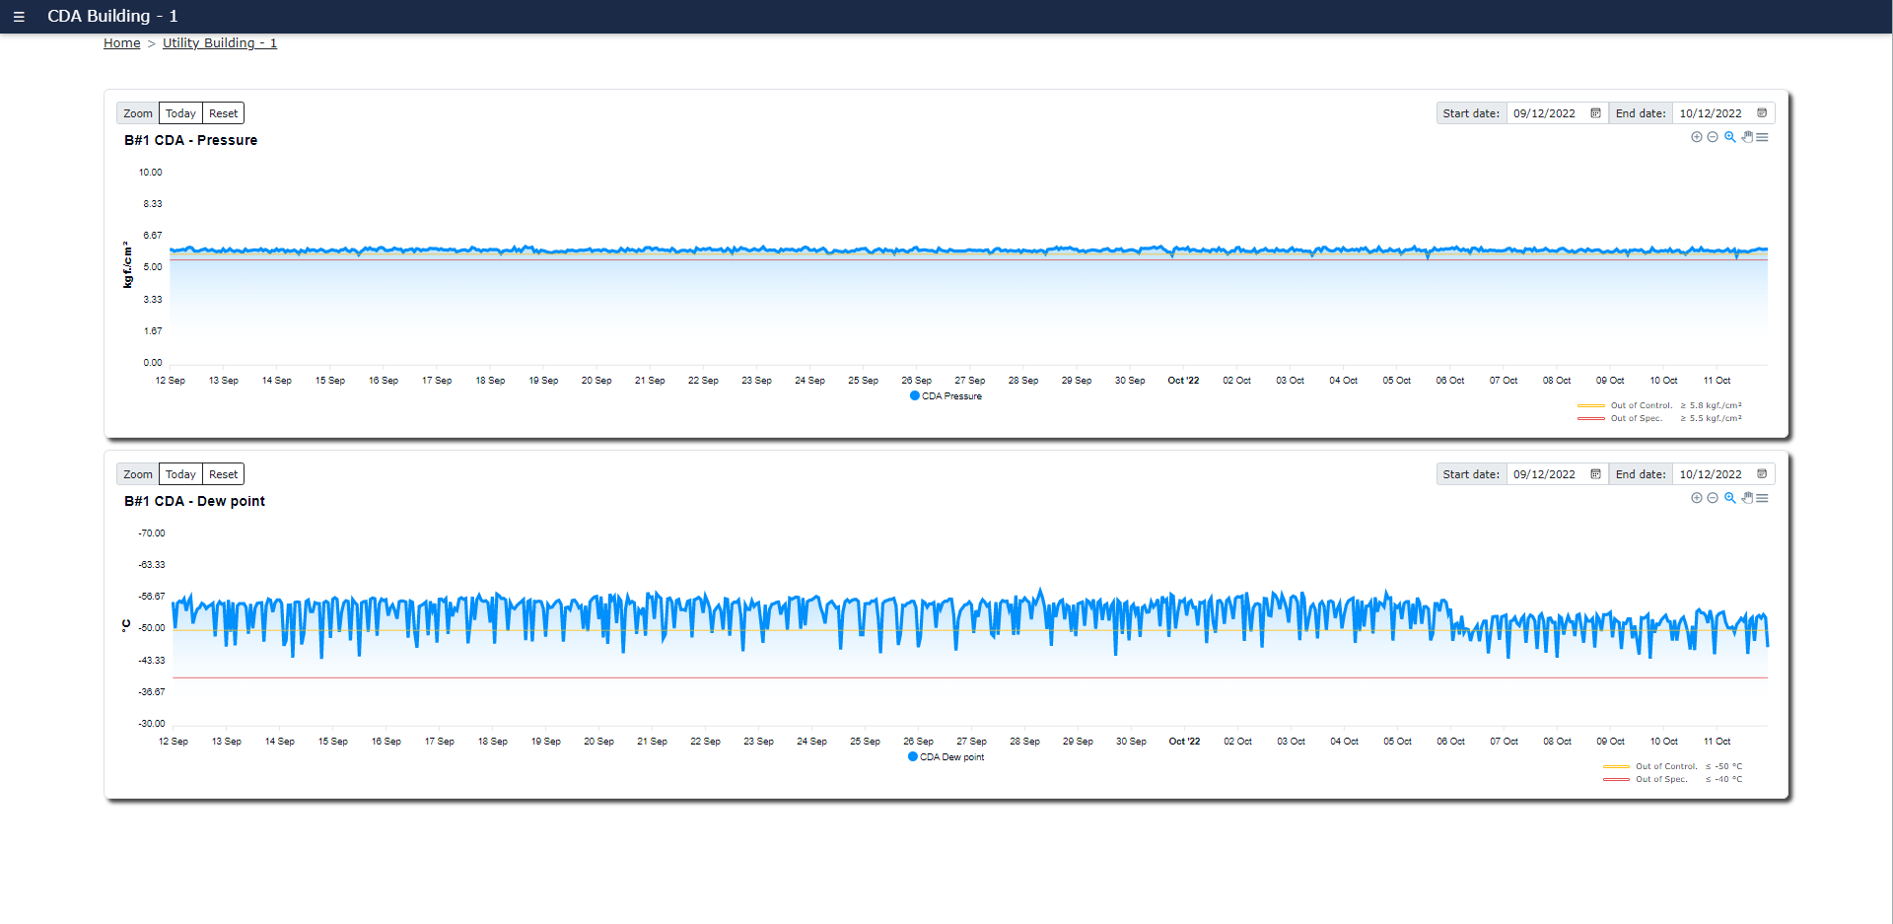
Utility
2
Centralized dashboard : To create the centralized dashboard by Data Summary of Utility on page.
System Name
Link to Trend(History)
Building Name
Value
Range for check value

Slide 25






The result of Internship
After training and learning about project assignment of SF080 FAC Dashboard , It was a valuable experience.
Before
Training
After
1. To training development tools for apply to project assignment
Business knowledge
.NET
Vue JS
Bootstrap
SQL Server
Apex chart
2. Self leaning
stack overflow
W3schools
SQL tutorial
To improve development skill up
Have more Development tooling knowledge
- .NET
- Vue.JS
- Bootstrap
- SQL Server
- Apexchart
2. Have more experience in businesses environment
Not enough knowledge for SDT dashboard development
Business knowledge
.NET
Vue JS
Bootstrap
SQL Server
Apex chart

Slide 26
What to expect after completing the internship

Slide 27
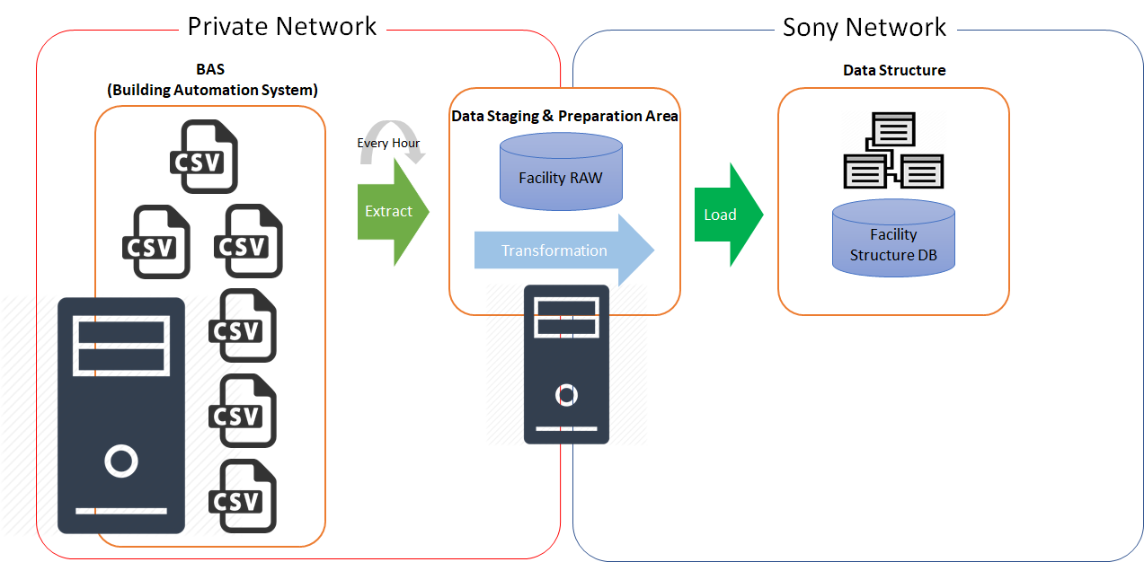
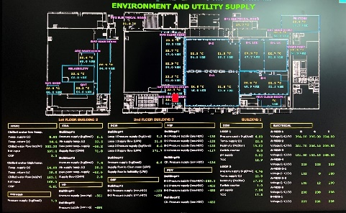
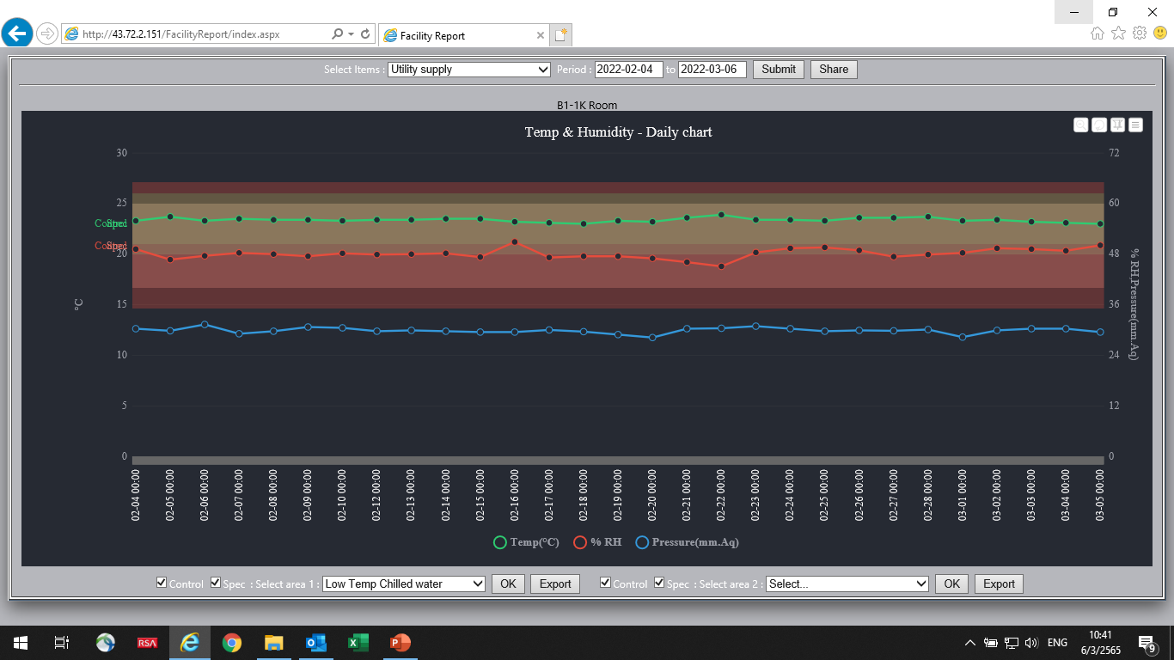
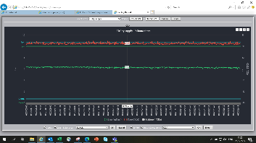
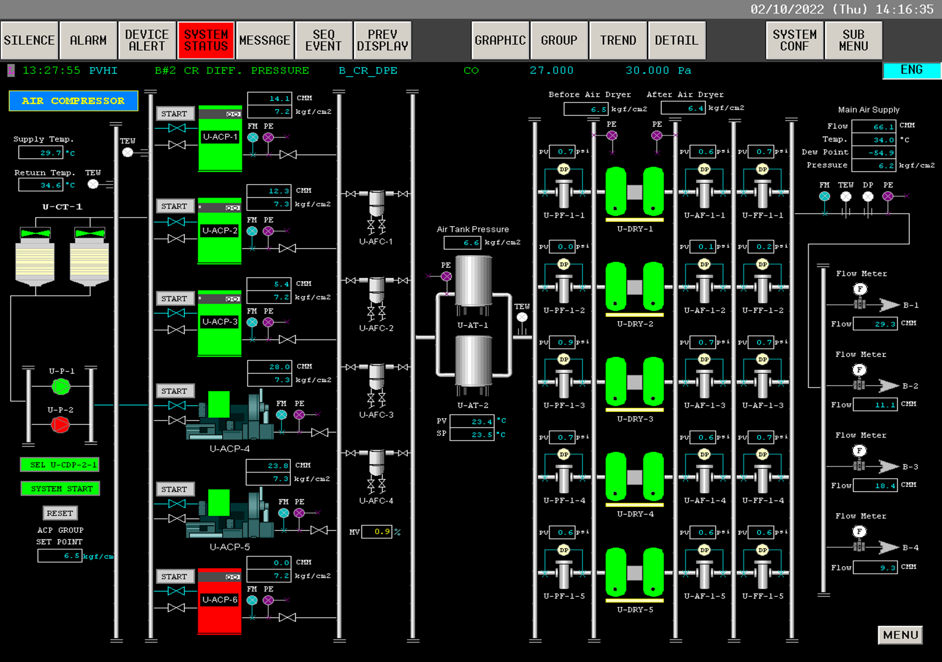
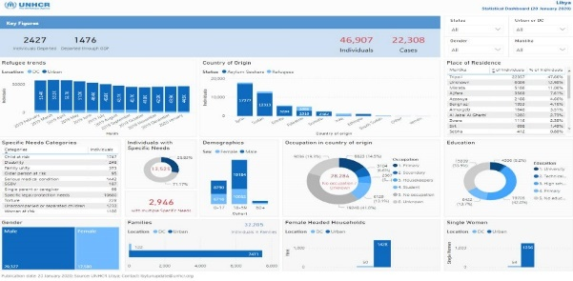
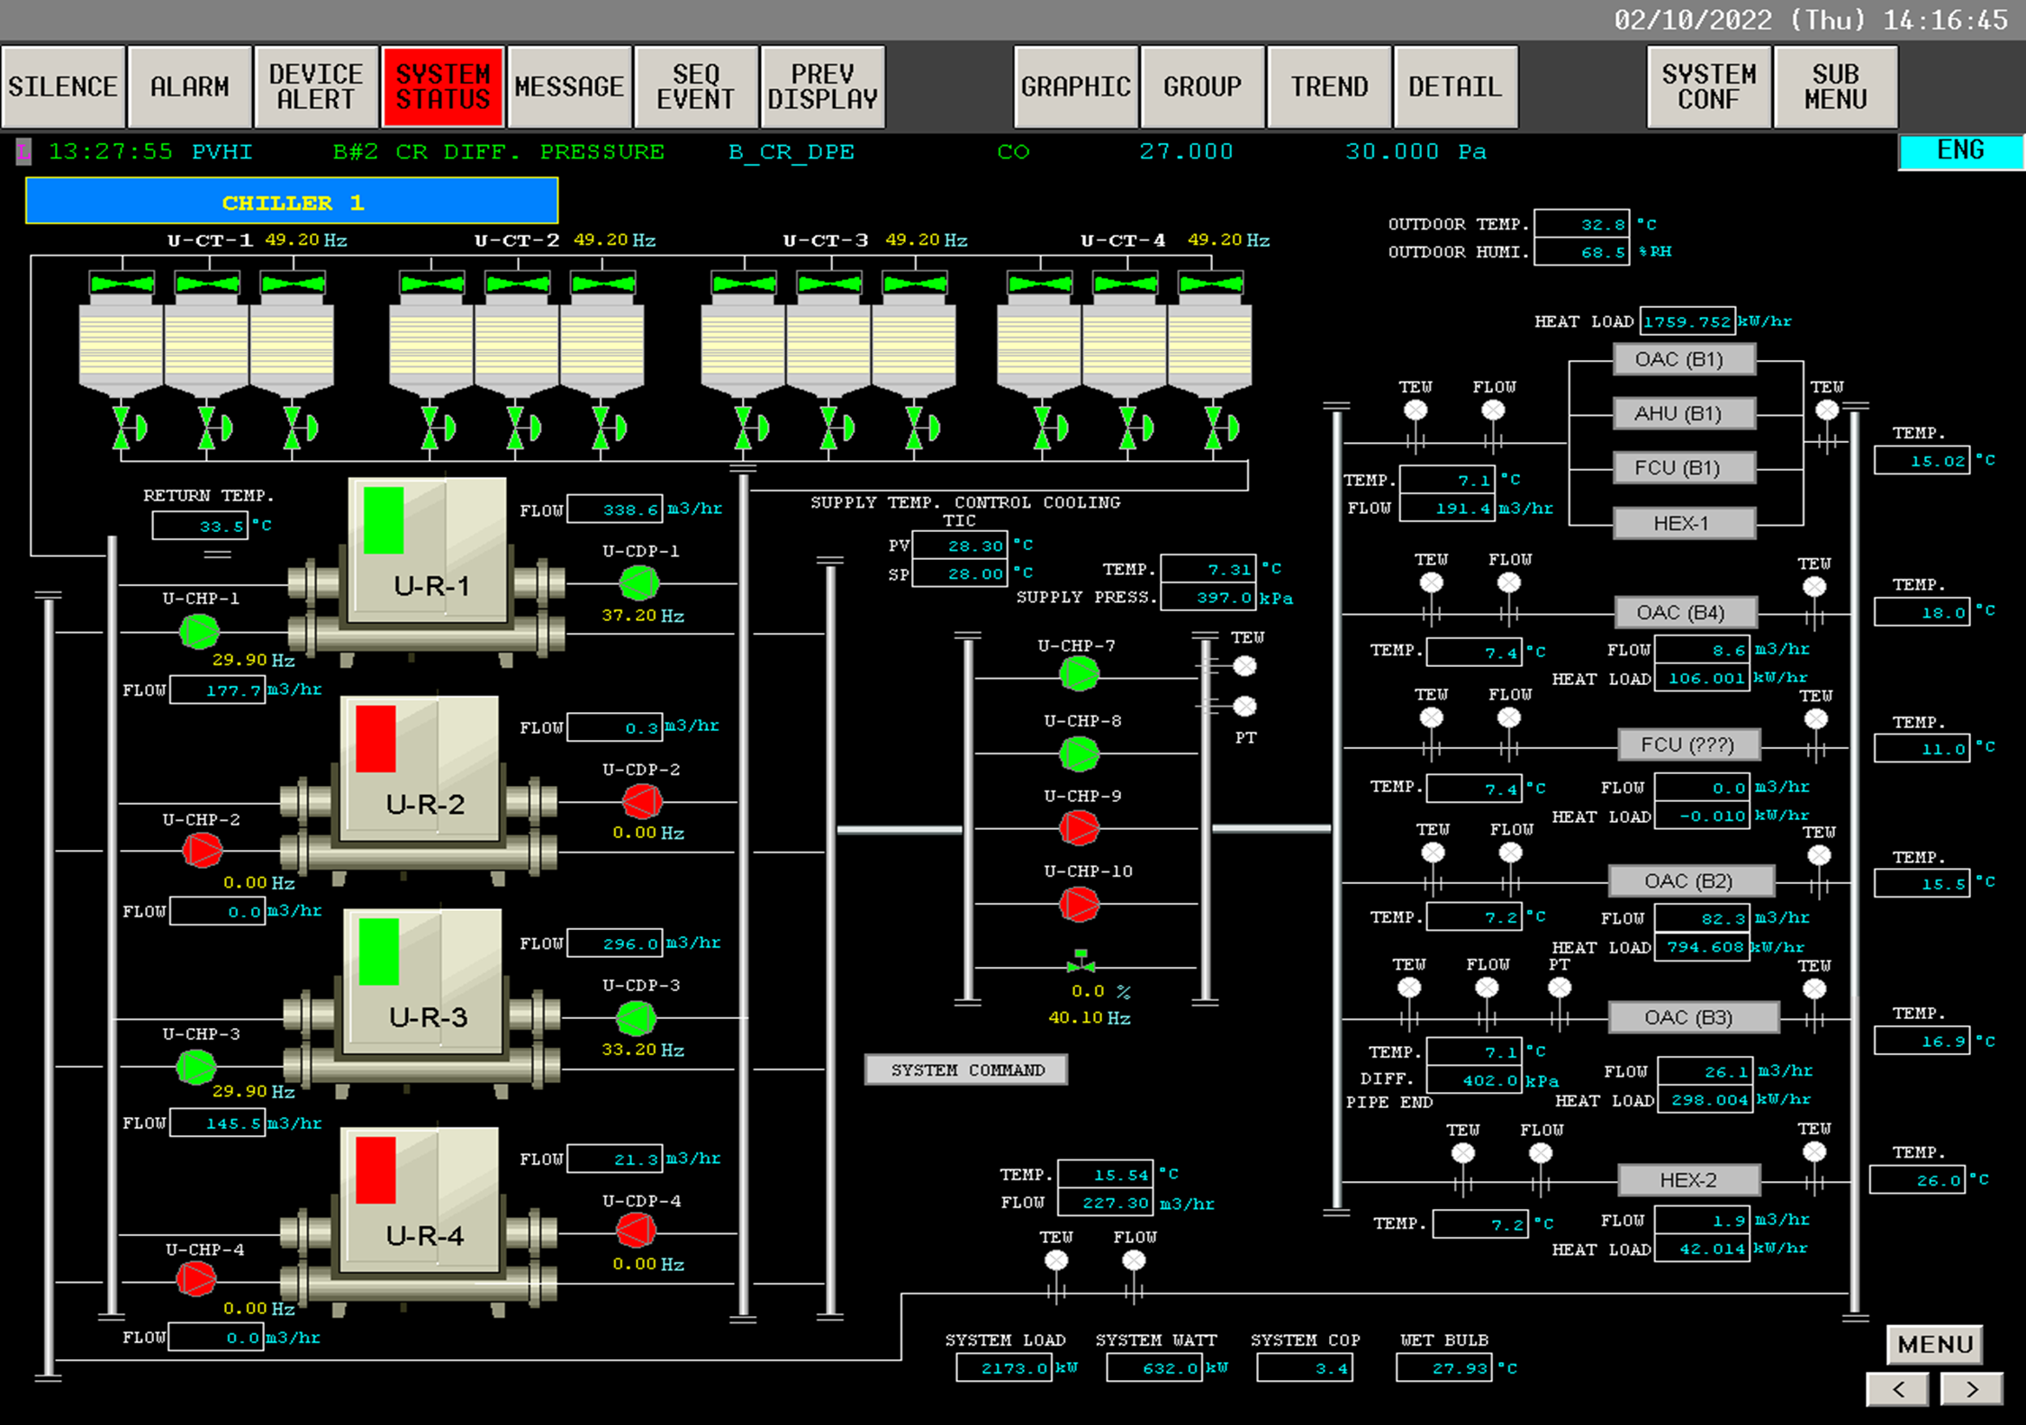
SF080 FAC Dashboard
Improve Virtual Display, User can easily access the data.
Situation
KPI
Activity-1 : Completion Sharing and display to SF Dashboard
System Diagram Development
BAS Control system
Present utility system are automatic control by graphic display monitoring, limitation alarm and remote
Present display and sharing to user via web link
[some time difficult to access]
Temperature,
Humidity
CDA
Pressure & Flow
Design Dashboard
To improve facility information
PIC : Apirome
Application : Arthit , Internship
Action | Apr 22 | May 22 | Jun 22 | Jul 22 | Aug 22 | Sep 22 | Oct 22 | Nov 22 | Dec 22 | Jan 23 | Feb 23 | Mar 23 | Apr 23
Learning & Detail Requirement
Dashboard Design
Make System Interface and confirm security
System Development
System Test & UAT
Training
Go live
Plan
Act
Dashboard Display design

Slide 28

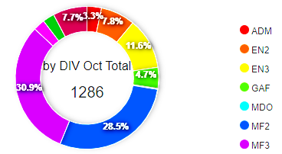
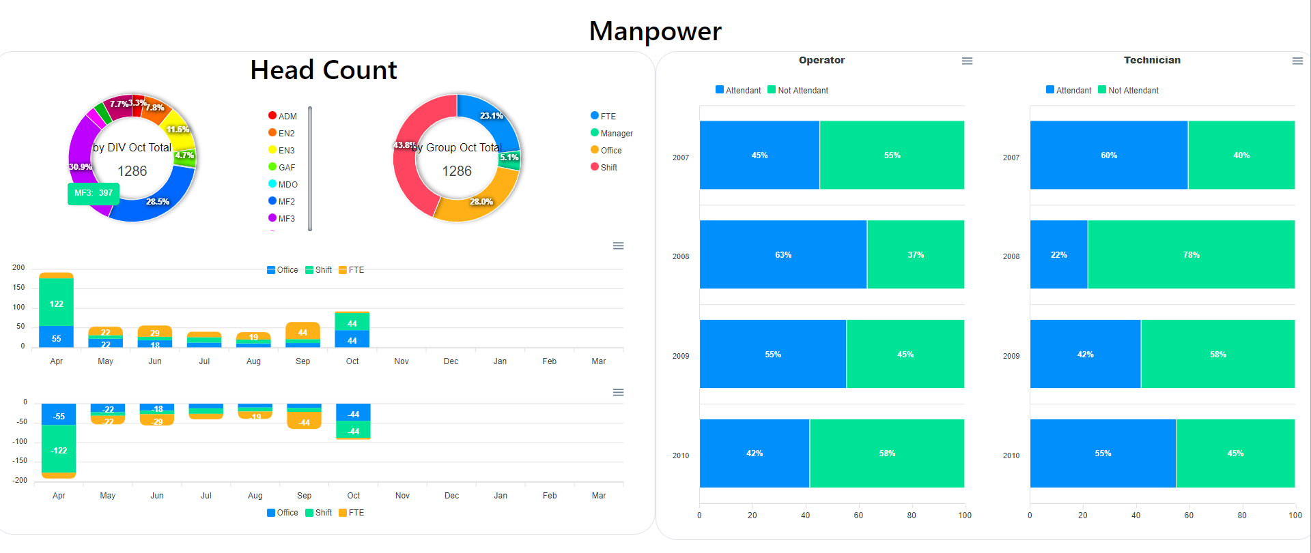
As Is
Manpower
LOAD
HR
Facility_RAW
Facility Structure DB
Data in Excel
To Be
LOAD
HR
Facility_RAW
Facility Structure DB
Dashboard

Slide 29
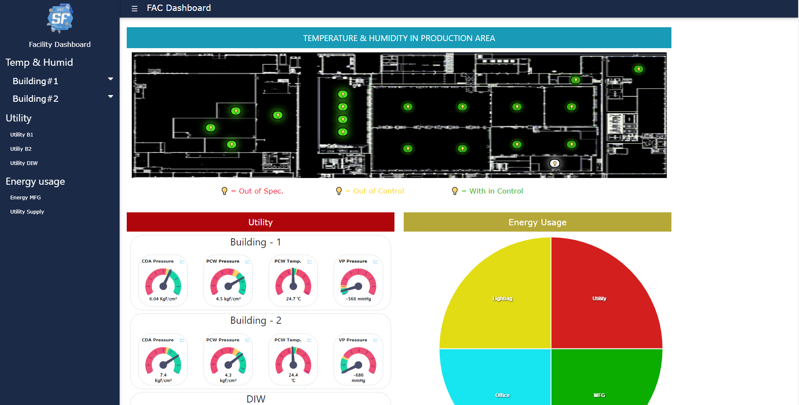
Technical : Data from database to create Chart on page FAC Dashboard
From SF080 requirements we develop by separate 5 parts to development
1
#เทคนิคการสร้าง Chart
Homepage FAC dashboard
Dev | Frontend | Database
Tools |  | Stored procedures
Result
Instance : DB_FACILITY
Stored procedures : SP_Get_Realtime_Temp
Stored procedures :SP_Get_Utility
Stored procedures :SP_Get_Energy

Slide 30
PROBLEM &Solution

Slide 31
Situation
Story ที่มาที่ไป
FAC Department
IT Department
Private Network
Every Hour
Export Data
LOAD
BAS
(Building Automation System)
Facility_RAW
Facility Structure DB
Notes:
สร้างมาเพื่อช่วยเหลือ ฝ่าย fac ให้รู้และ take action ได้ไวยิ่งขึ้น โดยที่ ฝ่ายFAC ของ SDT มี โปรแกรมสำเร็จรูป BAS เป็นโปรแกรมควบคุมระบบ Utility เช่น ระบบไฟฟ้า ระบบน้ำ ระบบควบคุมอณหภูมิ ความชื้น แต่ต้องใช้คนในการเข้าไปดูข้อมูลเพราะเป็นระบบ เน็ตเวิร์คแบบ ปิด จึงทำให้ม่สามารถดูข้อมูลจากภายนอกได้ทำให้ เปลืองคน ดังนั้น ฝ่าย IT ของ SDT จึง exact data ออกมาให้อยู่ในระบบเน็ตเวิร์คของ SDT ดังนั้น โปรเจคของเราคือสร้าง DASHBOARD จากดาต้า ที่ ฝ่าย IT

Slide 32
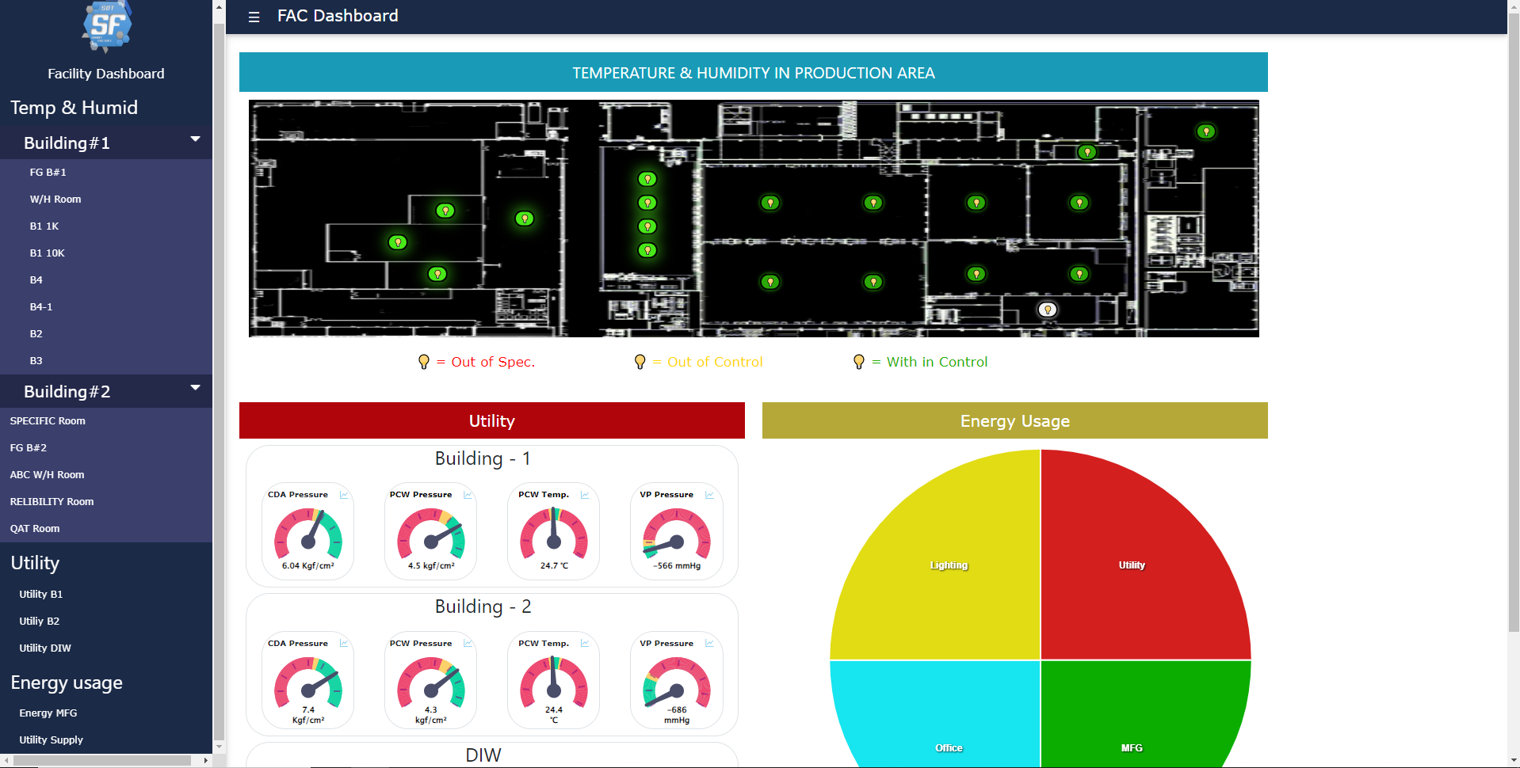
Activity
IT Department
Dashboard
Generate
Facility Structure DB

Slide 33
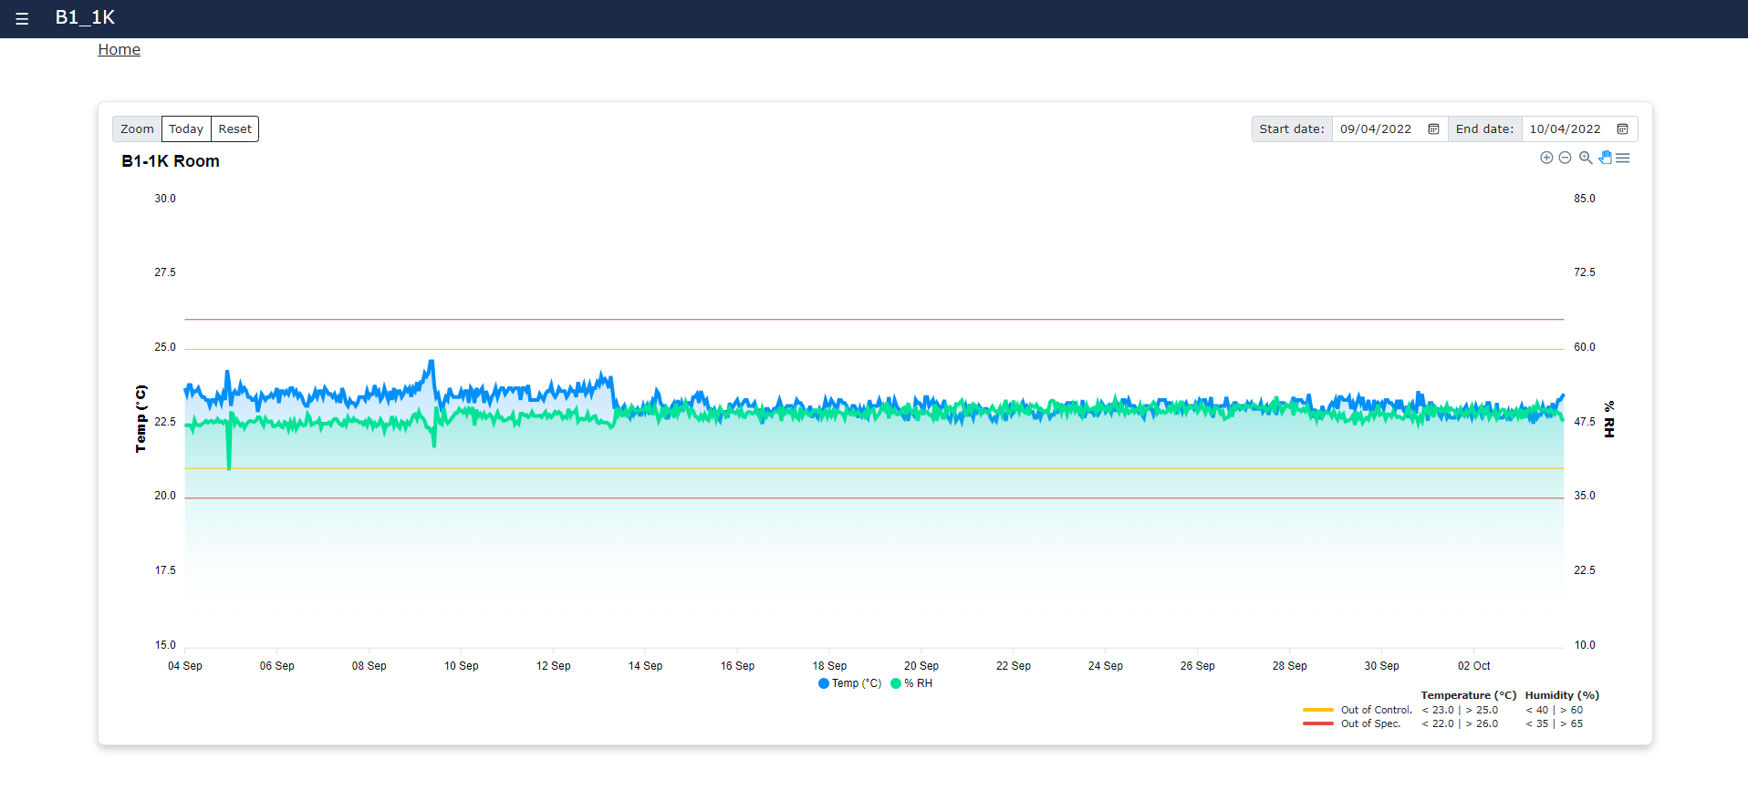
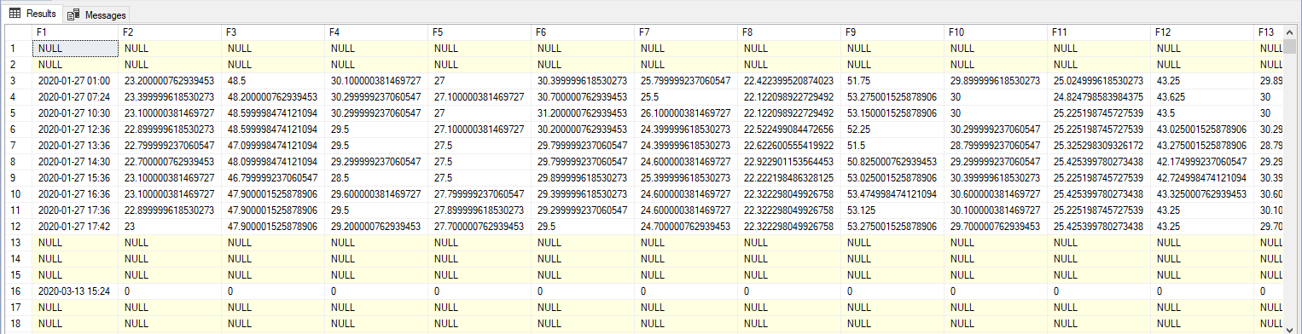
Project extension : SF080 SF FAC Dashboard
From SF080 requirements we develop by separate 2 parts to development
2
Temp & Humid dashboard
Dev | Frontend | Database
Tools |  | Stored procedures
Result
Stored procedures SP_Get_Temp_and_Humidity

Slide 34
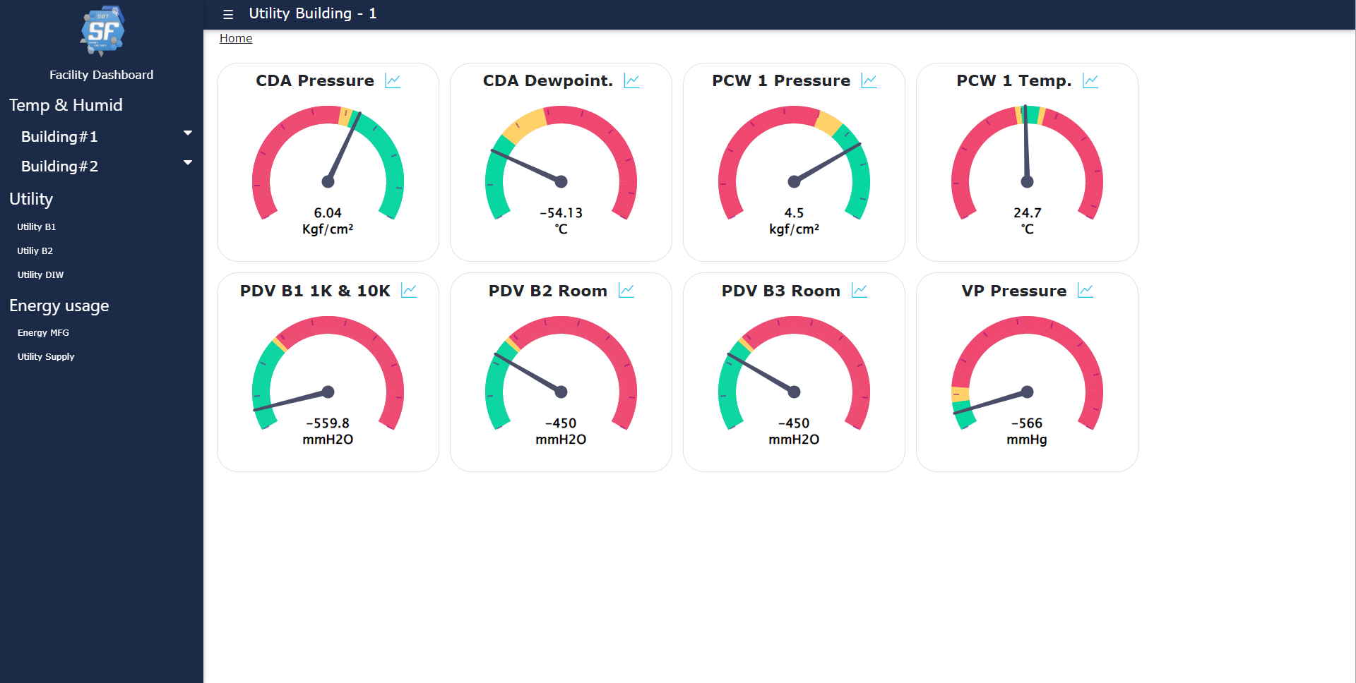
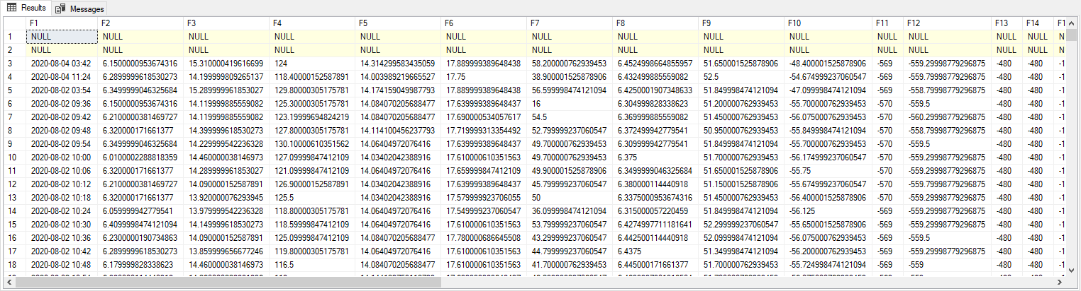
Project extension : SF080 SF FAC Dashboard
From SF080 requirements we develop by separate 2 parts to development
3
Utility dashboard
Dev | Frontend | Database
Tools |  | Stored procedures
Result
Stored procedures : SP_Get_Utility

Slide 35
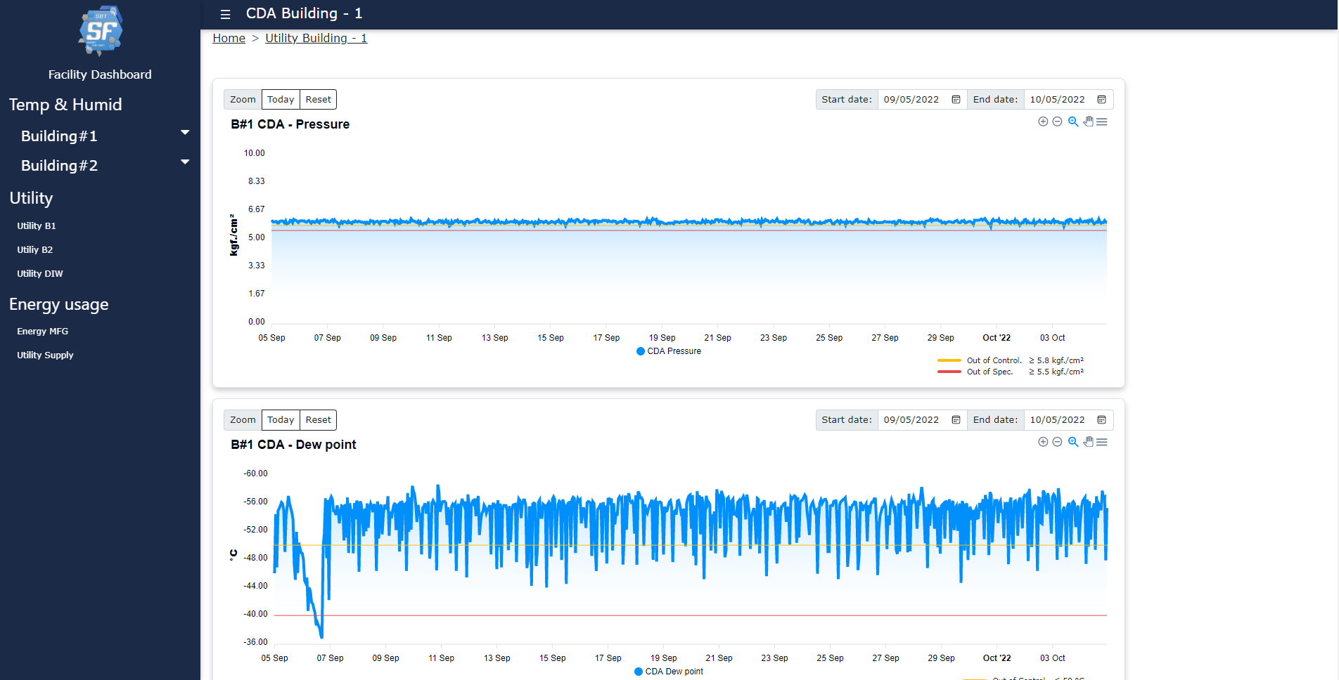
Project extension : SF080 SF FAC Dashboard
From SF080 requirements we develop by separate 2 parts to development
4
Utility dashboard
Dev | Frontend | Database
Tools |  | Stored procedures
Result
Instance : DB_FACILITY
Stored procedures : SP_Get_Utility

Slide 36
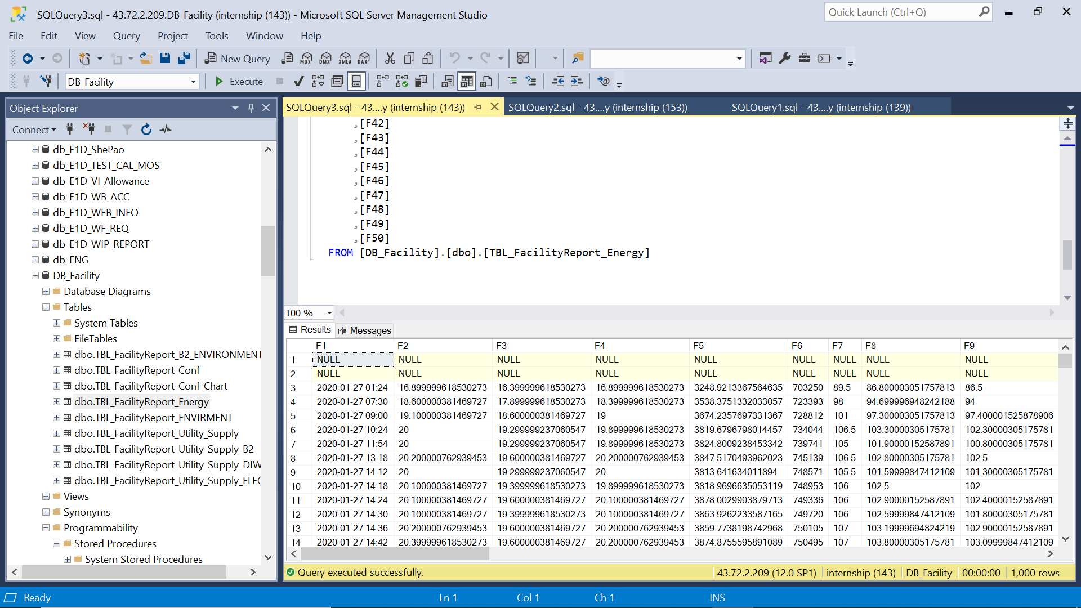
Project extension : SF080 SF FAC Dashboard
From SF080 requirements we develop by separate 2 parts to development
5
Energy dashboard
Dev | Frontend | Database
Tools |  | Stored procedures
Result
Instance : DB_FACILITY
Stored procedures : SP_ShowEnergy_TEST

Slide 37
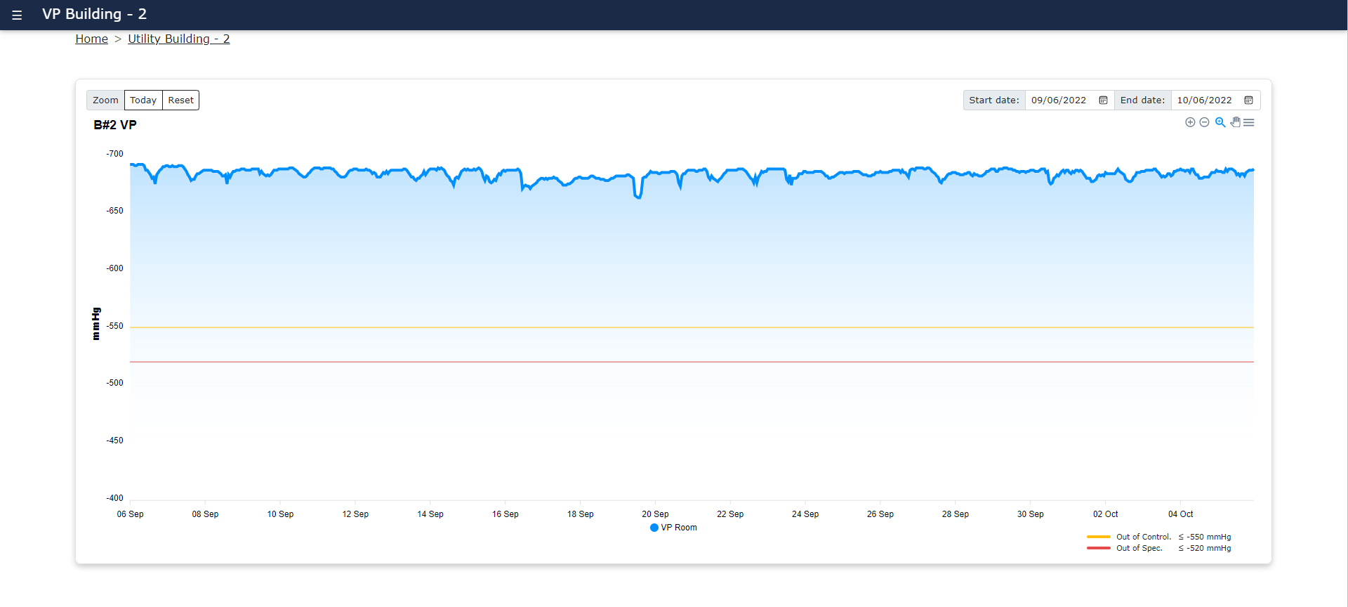
Project extension : SF080 SF FAC Dashboard
7
Sub page dashboard : To create chart for show more detail on page
Display Path
Select Date
Zoom In
Zoom Out
Data of Today and
Reset to default display
Panning

Slide 38
IE/MIT internship output
SF080 FAC Dashboard
To built up UI and generate data from SQL store procedure and views

Slide 39



Slide 40












MIT Internship Action Plan
After internship to join SDT, MIT to set training and assignment plan by SF dashboard improvement
Internship
MIT
Excel to Data SQL
Design Chart and layout
New BGT(Apr)
Begin of May
Request
Discuss
Discuss
Create
Survey and Create project
Project selection
Meeting with PIC
Set KPI and schedule
Draft to excel
Review with management
Suggest
Mid of May
End of May
Begin of Oct
Reply
Issue
Next
Next
Revised or complete
Share to Management
Submit in POMS
Approval workflow
GAF
Mid BGT Review and adjust
Summary
Promote
Bonus

Slide 41








Final Conclusion : SF080 SF FAC Dashboard
After training and learning about project assignment of SF080 SF FAC Dashboard , It was a valuable experience
Situation and problem
Activities
Result
We have many KPI , monitoring report separately in many system and report.
It spends time to summarize for overall situation.
To take action to improve SDT FAC dashboard
Study dashboard solution
Set meeting to discuss about current situation and requirement
Set project schedule plan
Follow requirement and schedule plan
Completion sharing and display SDT FAC dashboard
Temperature
Utility
Energy Usage
SDT
Not enough knowledge for SDT dashboard development
Business knowledge
.NET
Vue JS
Bootstrap
SQL Server
Apex chart
1. To training development tools for apply to project assignment
Business knowledge
.NET
Vue JS
Bootstrap
SQL Server
Apex chart
2. Self leaning
stack overflow
W3schools
SQL tutorial
To improve development skill up
Have more Development tooling knowledge
Have more experience in businesses environment
Nonthawat
Jirapat

Slide 42
Each project

Slide 43
SDT Internship : Programmer
16 Aug 2022
Sony Device Technology (Thailand) Co.,Ltd.

Slide 44
Agenda
1. Introduction (5 minute)
-SDT improvement : Smart Factory
-Requirement &Job assign -> 4 Team
-Overall schedule
2. Training (3 minute)
- Line tour
- Development Tooling
3. Project Progress (7 min / team) Each team
SF080 : FAC Dashboard
SF081 : Homepage
SF097 : Machine Dashboard
SF102 : Customer dashboard
4. Q&A
*Situation
-Biz logic, Technical term
-Problem (as is , to be)
-Output image
*Activity
-Apply knowledge
-Require Technic
*Schedule
*Example screen

Slide 45

Training overview
To train SQL database

Slide 46

Internship job assignment

Slide 47

Training overview
To train .NET

Slide 48

















IT Utilization for Production Line Information
Utilize IT to transform actual data in production line to be “Quality Information” for “ Effective Management”
Actual Data
Information
(Digital)
New Application
Important Report
Paper Record
E-Record
Daily Report / near-miss alert
Transform
Summary & Analysis
Report
Visual Control
Machine
PC
Tools
SQL Server
(Data table)
Quality
Delivery
Cost
Select and Transform useful actual data in production line to be digital information and collect in SQL database for easy summary and analysis
Develop new application / Tools in order to create important report for Effective Management with Speed and Accuracy.
Effective meeting
Event

Slide 49






IT Utilization for Office Work
Utilize IT to create new tools for reducing manual routine job ➔ improve speed and deeply analysis
Current Situation
Improvement Tools
Smart Office
Data
Center
One click
complete!
Material
Fcst & Control
Material usage
Daily plan
Expense Control
Material Yield
Expense & Investment
Cost Analysis
iBOM
iDoc
Major Defect
HC & OT
Purchasing schedule
Daily plan
Machine Database
Material Yield
Resource Allocation
- Office members do many manual routine job.
- Spend much time to summarize data and make report
- Create database as data center to collect and control important data
- Develop new program to improve speed and accuracy of routine job.
- Transform information by human knowledge to be formula/condition for clarifying the decision making/ judgment of each function
- Change manual routine job to be auto-report
- Office members focus on data analysis and decision making

Slide 50




















Plan & Order Support
Machine Operation
MFG Operation
SF Big Data
Other Support
Quality Control

Slide 51

Dashboard center image
To create multiple dashboard by each items

Slide 52

Add Internship

Slide 53







SF081 : [SF] SF Homepage & Dashboard
Provide convenient tool for employee self learning for Smart Factory
and provide overall SDT situation through Dashboard
Situation
KPI
Activity
We have many KPI , monitoring report separately in many system and report.
It spends time to summarize for overall situation.
1. Completion sharing and display Dashboard on SF Homepage
SDT Dashboard
Employee education
design base on view of 3 level
Management
Analysis
Operation
Project coverage
Project concept
Technical adaptation
VDO demonstration
2. Completion sharing SF knowledge
Quality
Delivery
Cost
PIC : Pongkhun / Puttaraksa
Application :Thiti, Ploypilin , Internship
Action | Apr 22 | May 22 | Jun 22 | Jul 22 | Aug 22 | Sep 22 | Oct 22 | Nov 22 | Dec 22 | Jan 23 | Feb 23 | Mar 23
Detail Requirement
Homepage and Dashboard Design
System Development
UAT and training
Go live
Plan
Act
Dashboard
Employee education

